Slide 1

FIFA WOMEN’S WORLD CUP
Obinna Ibe
"Football is not just a game, it's a passion"

Slide 2
Project Summary & Objectives
Objectives:
Steps Summary:
To evaluate FIFA women’s performance of different teams and players
To give players and coaches a strategic analysis in order to prepare adequately for future games
Establishment of clear insight which helps squads to make data-driven decision
To engage fans by providing them with insightful analysis and statistics that can enrich the viewing experience and deepens their understanding of the game.
A thorough research and understanding of each variable in the data
Formulation of research questions
What is the total goals, penalty, assists, red and yellow card
What is the trend of goal in relation to squads and year, etc.
Querying of data using SQL
Data cleaning using Power BI
Data visualization
Presentation
"Football is not just a game, it's a passion"

Slide 3

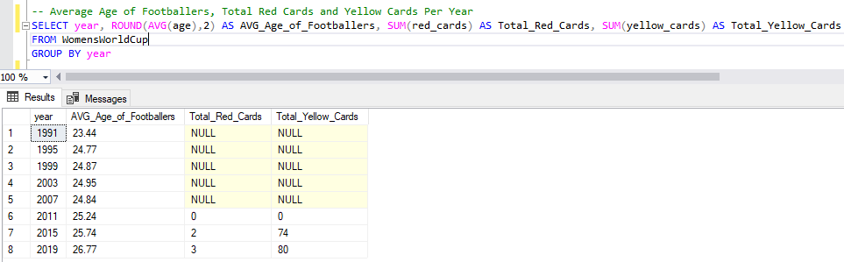
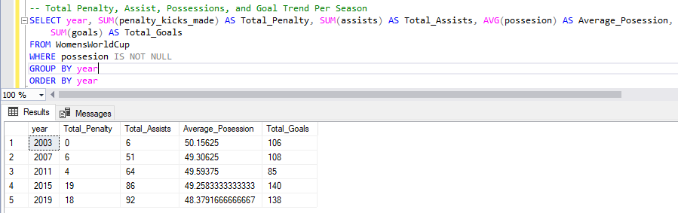
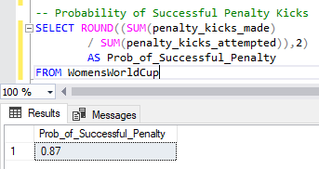
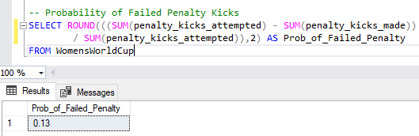
Data Cleaning and Exploration
Data Cleaning:
Obtain data information which showed that the data had 21 variables and 136 records.
Checked for data quality and data type.
Reformatted Squads as countries in order to get a map of the squad
Checked for duplicates which we observed none.
Discovered 3 variables with incomplete values which include; red card and yellow cards (1991-2007), possessions (1991-1999).
Data Exploration Using SQL
To analyze the probability of having a successful and failed Penalty Kick,
Estimate Total Penalty, Assists, Average Possession, total number of Red and Yellow cards.

Slide 4
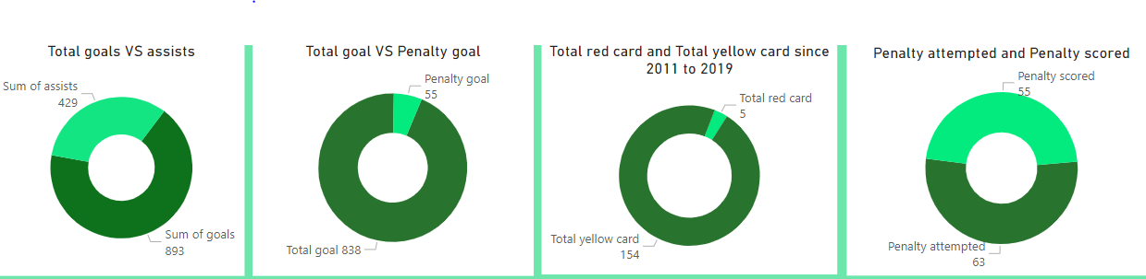
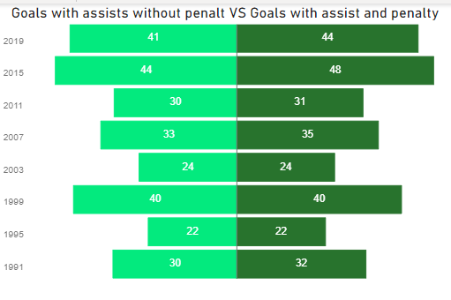
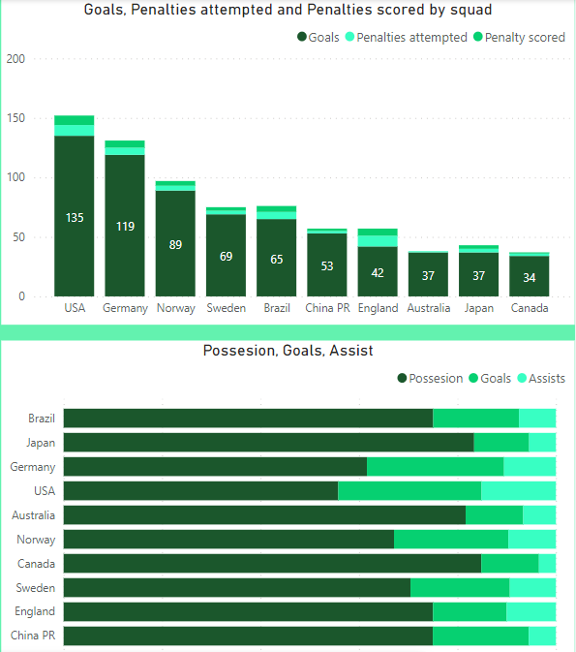
Visual Brief:
VISUALIZATION
The players scored a total of 893 goals across all competitions within 8 Seasons of FIFA Women’s World Cup. This marks an average of 1.57 goals for all the 568 games played so far. However, out of the 893 goals scored by these players, 55 of them were penalties. So, this statistic indicates that the players scored an average of 1.48 goals in each game without penalty. Out of the 63 penalties attempted, 55 were scored which gives it an 87% success rate.
The USA had the highest goals of 135 and Brazil had the highest Possession of 280.10.﻿﻿ In the first 90 mins of games, fewer goals were observed compared to the game gotten during extra time. At 140, 2015 had the highest goals and was 64.71% higher than 2011, which had the lowest goals at 85.﻿﻿ ﻿﻿ Only about 159 offenses have gotten a card with 5 out of the 159 being red cards and the rest yellow.
Using the Correlation function in Ms. Excel, it was recorded that Goals and Total Penalty Kicks Attempted are positively correlated with the 0.399 Correlation Coefficient.﻿﻿ ﻿﻿ ﻿﻿USA accounted for 15.12% of goals across seasons.﻿﻿ ﻿﻿ ﻿﻿Across all top 10 Squads, Goals ranged from 34 to 135, Penalty Kicks Attempted ranged from 1 to 9, and Penalty Kicks scored ranged from 0 to 8.﻿﻿ ﻿﻿ ﻿

Slide 5

Note
Over the year, there have been agitations about whether FIFA Women’s World Cup will see the light of day. However, from research, the potential of women’s football teams is noteworthy and according to FIFA, the global governing body of football recorded that the number of women and girls playing football has been progressively increasing, with more than 30 million female players worldwide. This invariably means that there is a need for awareness of sports among women and girls, which can bring about upturning participation and support for the sport in the future.
This tournament needs more sponsors to keep it running continuously, which will also help to increase perceptibility and generate more revenue for the sport. As a result, this can help to support the development of women’s football at all levels, from grassroots to professional. Even though women’s sport is still far behind men’s football in investment and perceptibility, it keeps showing very strong growth over the years, especially in countries like the United States, China, and Europe, where women are displaying great potential for the sport to keep growing.
On the dataset, the red card, yellow card and possession variables need to be completed as they are incomplete at the moment, player’s individual age and goal(s) scored are needed in order to determine if there is a relationship between goals scored and the age of a player.
"Football is not just a game, it's a passion"

